Slide 1
Similarity Network Fusion
bluerose73
yik

Slide 2
Background
multiple and diverse genome-scale data
integrative methods are essential for capture biological information
Integrative challenge
- the small number of samples compared to the large number of measurements.
- the differences in scale, collection bias and noise in each data set
- the complementary nature of the information provided by different types of data
identification of homogeneous subtypes in one cancer

Slide 3
Former methods
concatenate normalized measurements
- low signal-noise ratio
analyze each data type independently before combining
- hard to integrate
preselect important genes and use Consensus Clustering
- biased analysis

Slide 4
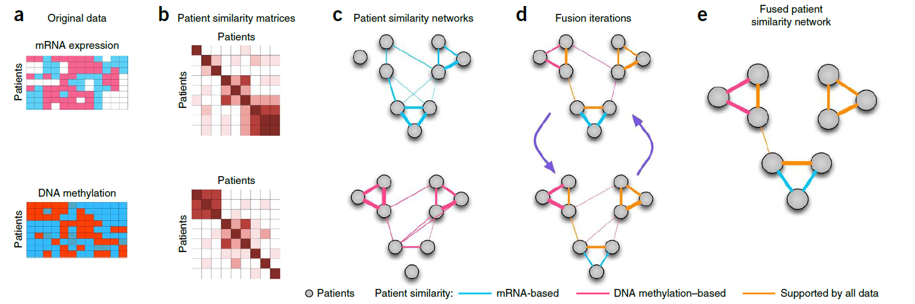
SNF
Main steps:
- construct a sample-similarity network for each data type
- integrate these networks into a single similarity network using a nonlinear combination method

Slide 5
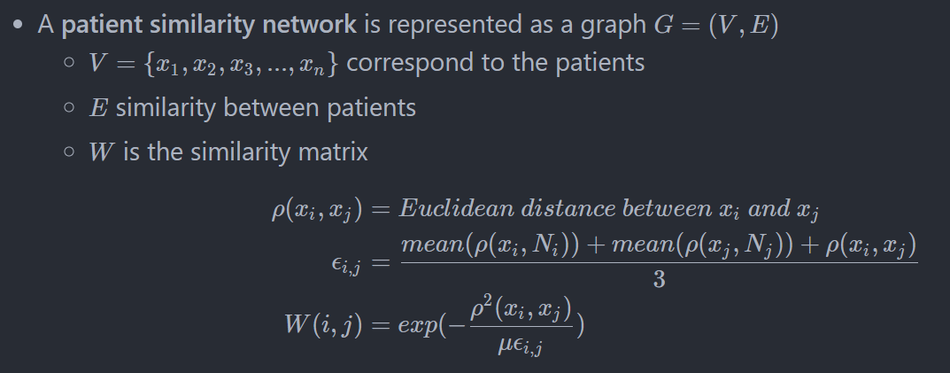
Details:

Slide 6
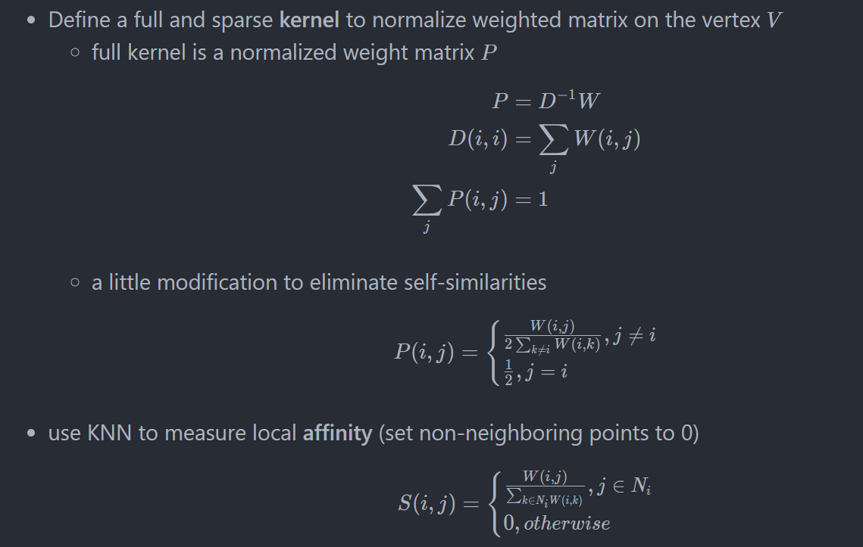

Slide 7
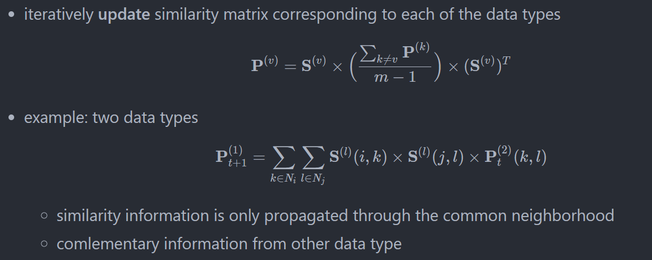

Slide 8
Advantages
- capture both shared and complementary information, offered insight into how informative each data type is to the observed similarity
- derive useful information from a small number of samples
- robust to noise, data heterogeneity and scales to a large number of genes
- make efficient identifies of subtypes among existing samples by clustering and predict labels for new samples

Slide 9
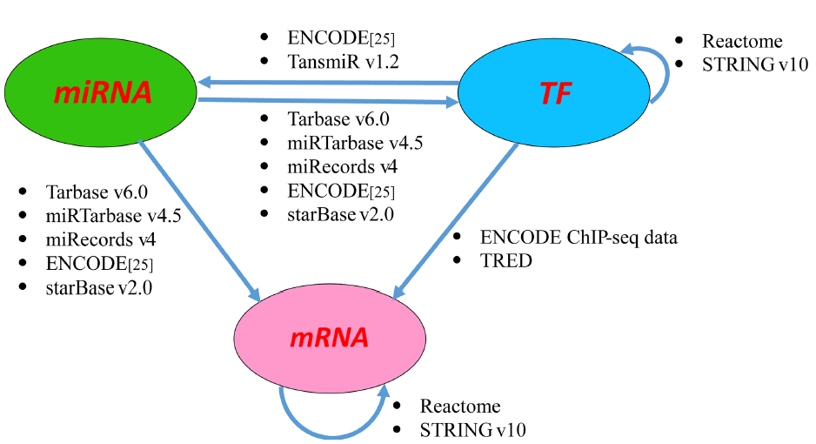
WSNF
Background
- Existing methods rarely use information from gene regulatory networks to facilitate the subtype identification. In other words, the information between features is ignored.
Main steps:
- Construct the regulatory network
- Calculate feature weights
- Weighted similarity network fusion

Slide 10
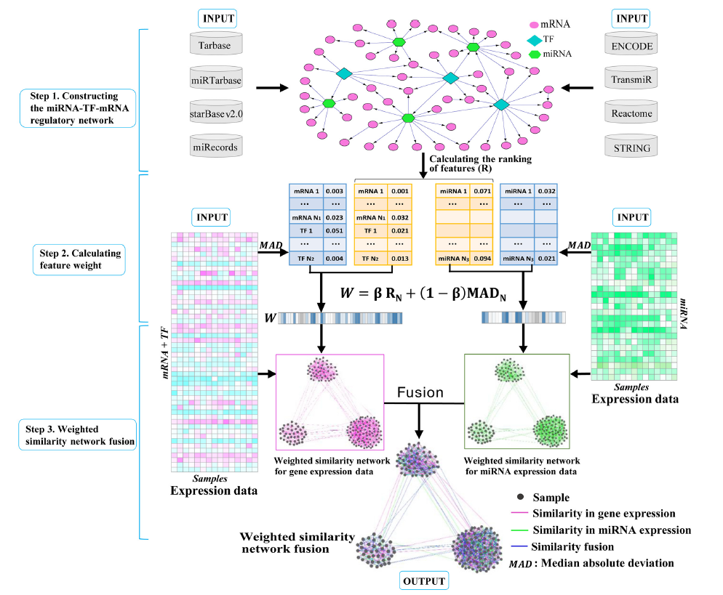

Slide 11
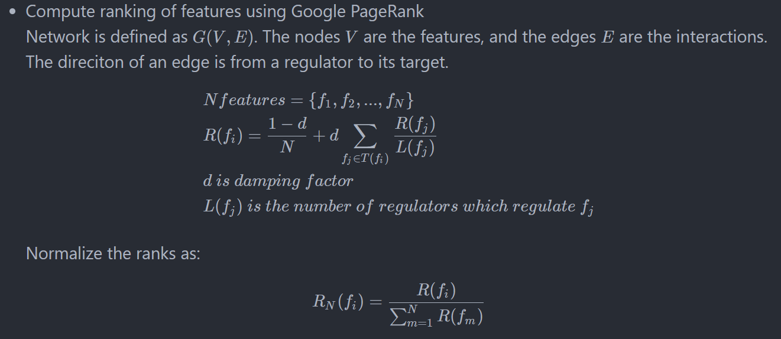
Details:

Slide 12
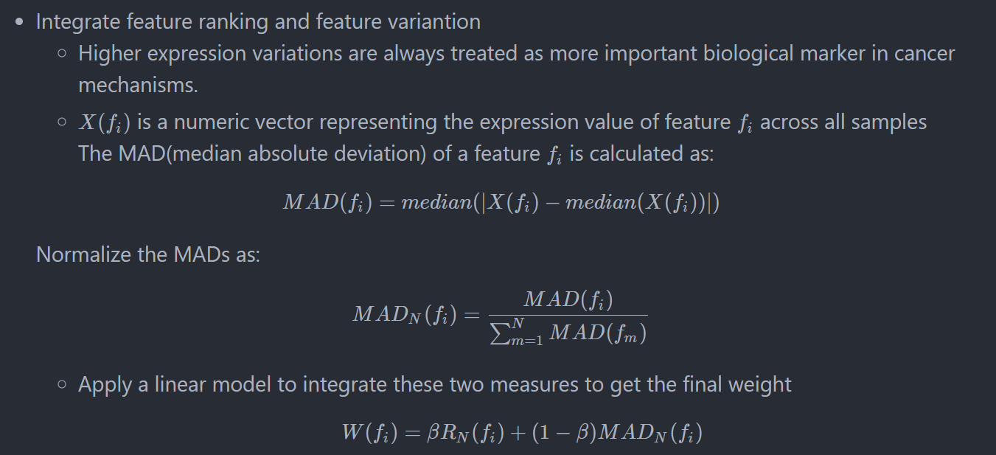

Slide 13
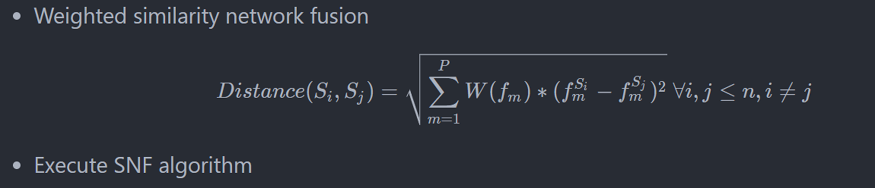

Slide 14
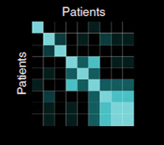
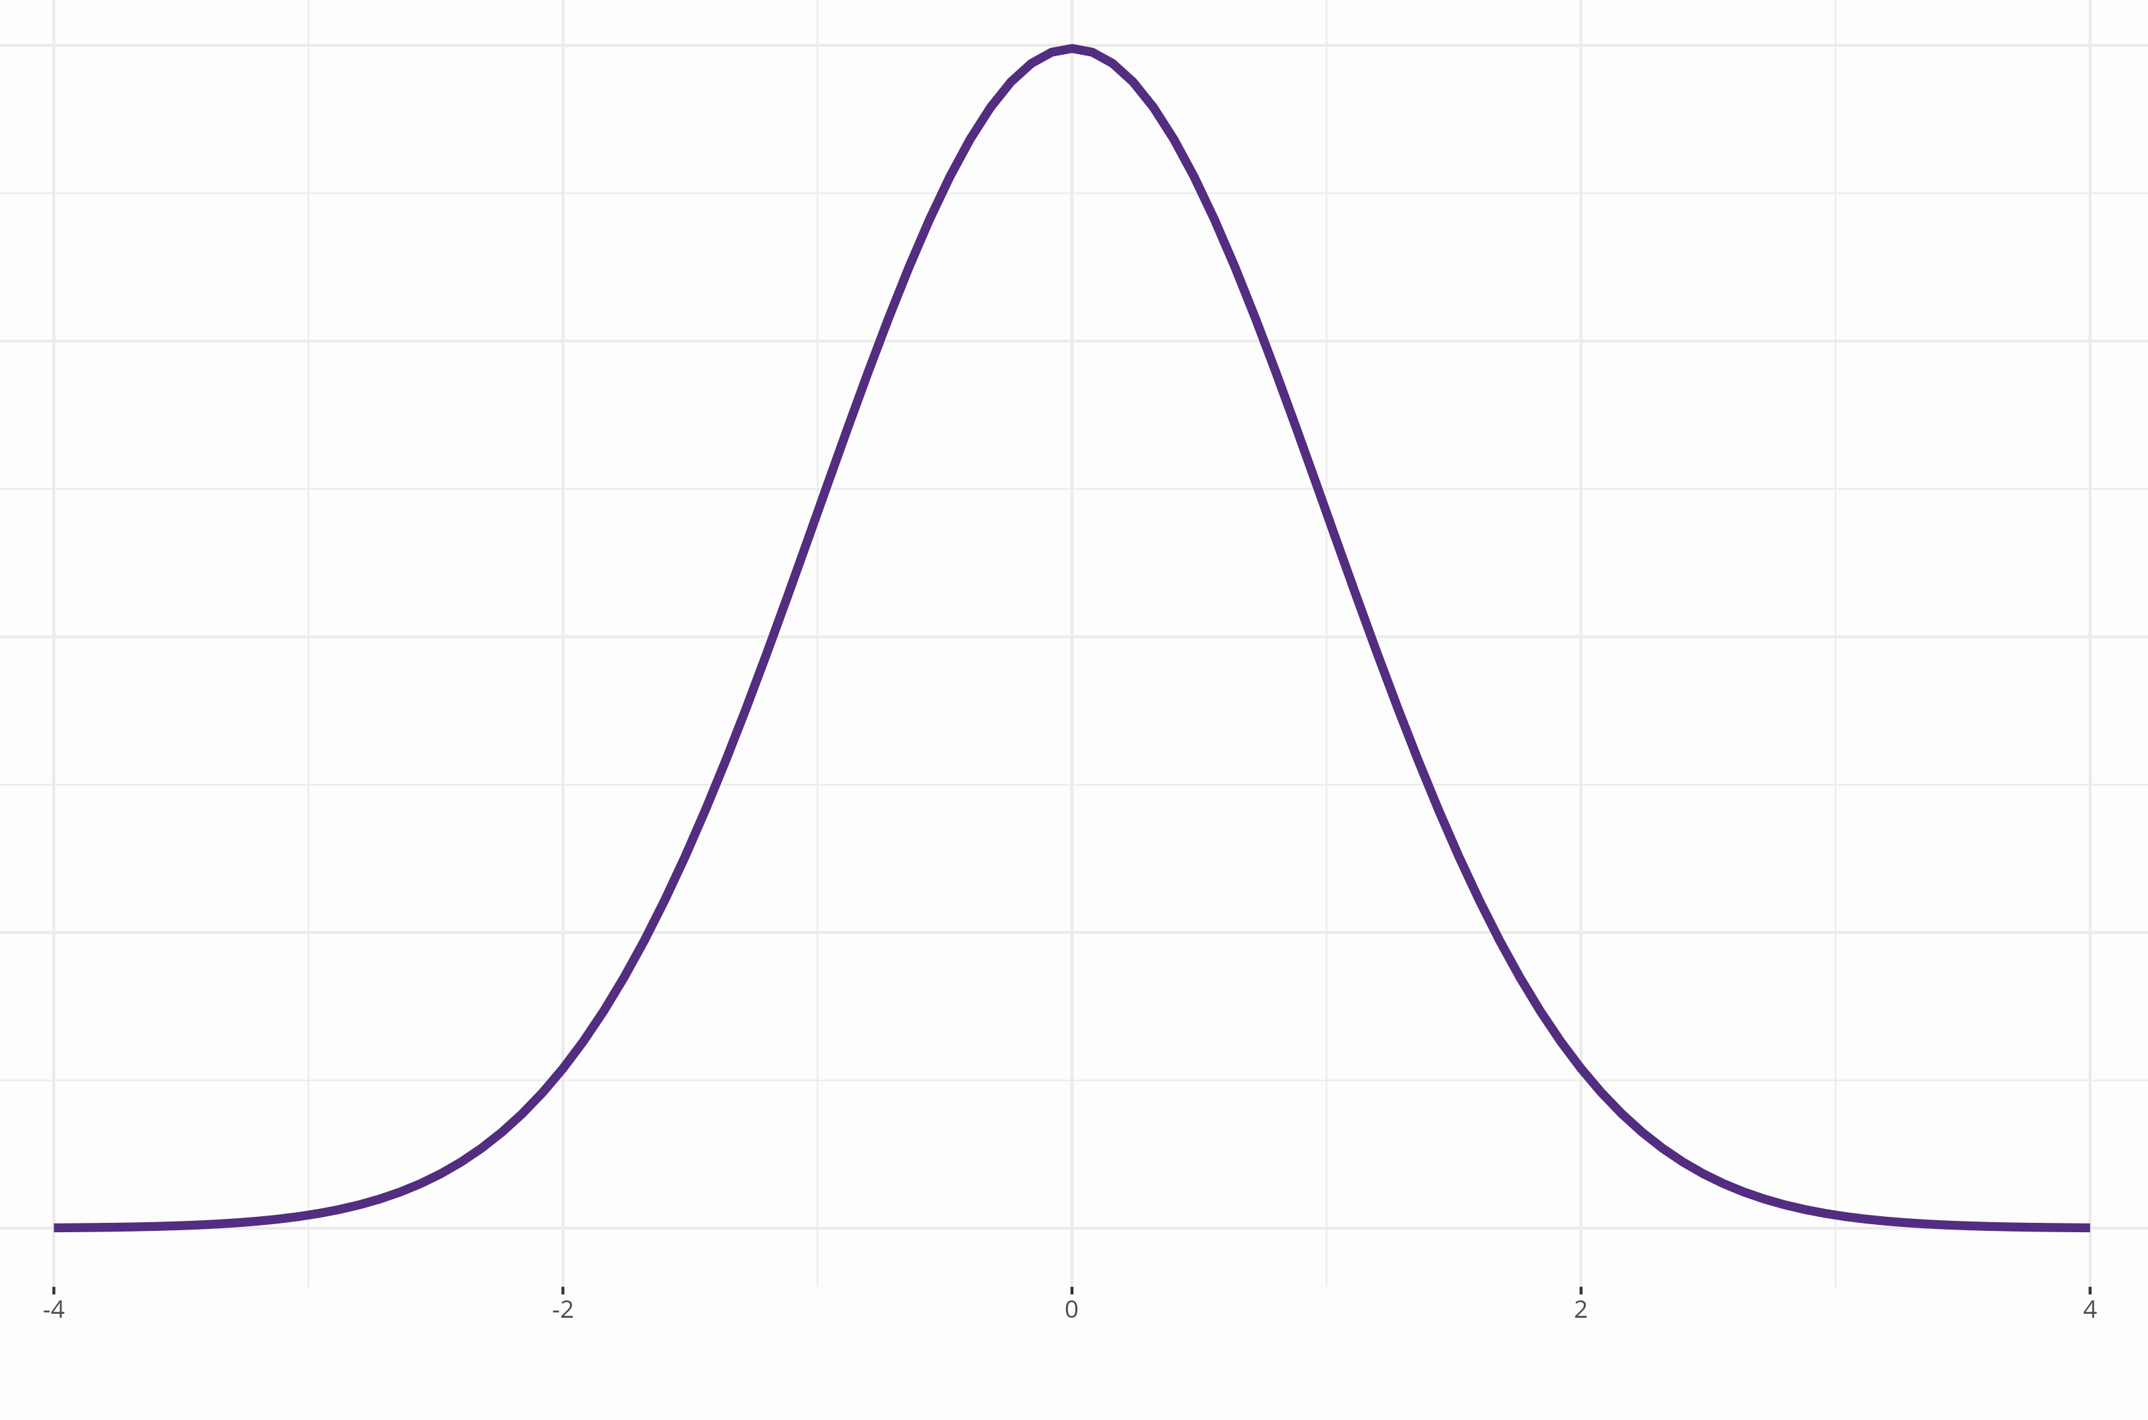
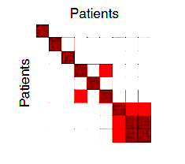
ANF：Affinity Graph
Gaussian kernel
Euclid distance
Fusion!
+
K nearest neighbor
pruning

Slide 15
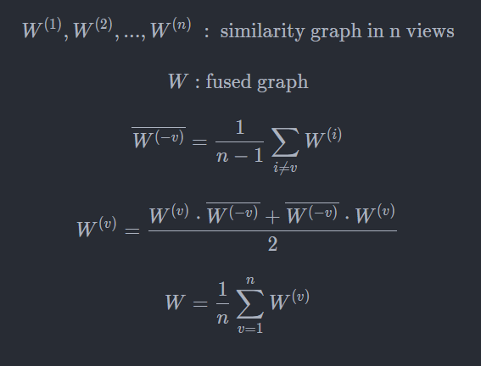
ANF: Graph Fusion
Intuition:
Similarity graph can be regarded as a state transition matrix, where the similarity between patient i and j is the probability of state i transitions to patient j.
Multiplying two similarity matrix is a 2-step random walk on the transition graphs.

Slide 16
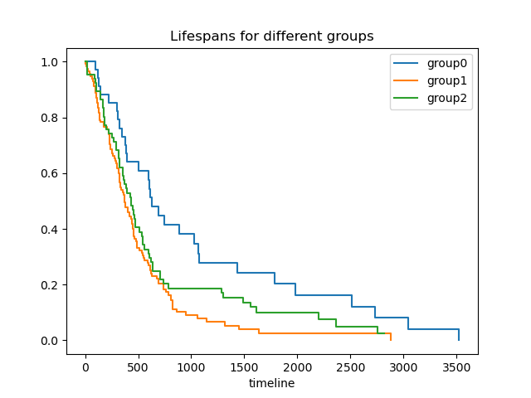
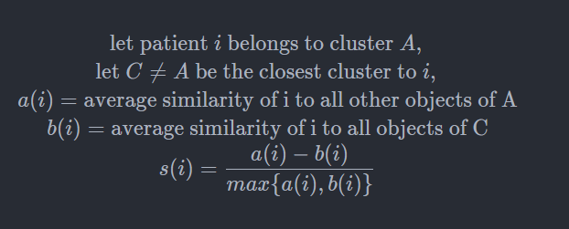
Evaluate Clustering Performance
Ground truth available: accuracy, NMI, ARI, ...
No ground truth: survival analysis + Silhouette score
log rank test provides the difference
between two survival curves (in p value)
Silhouette score measures
how similar an object is to its own cluster
compared to other clusters

Slide 17
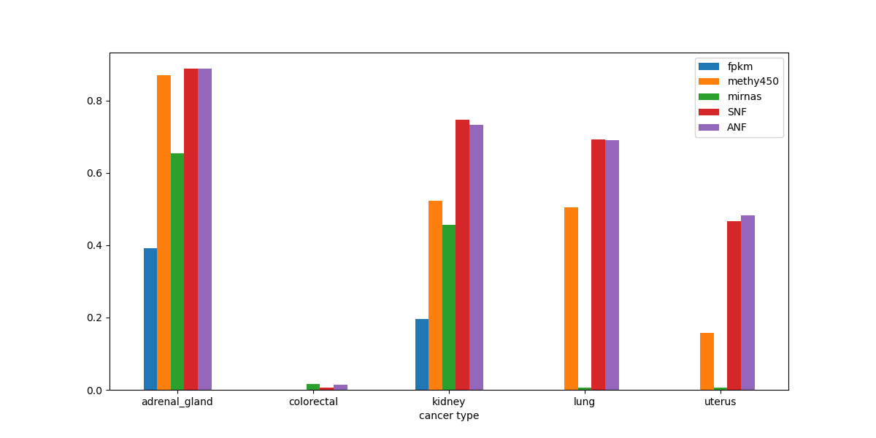
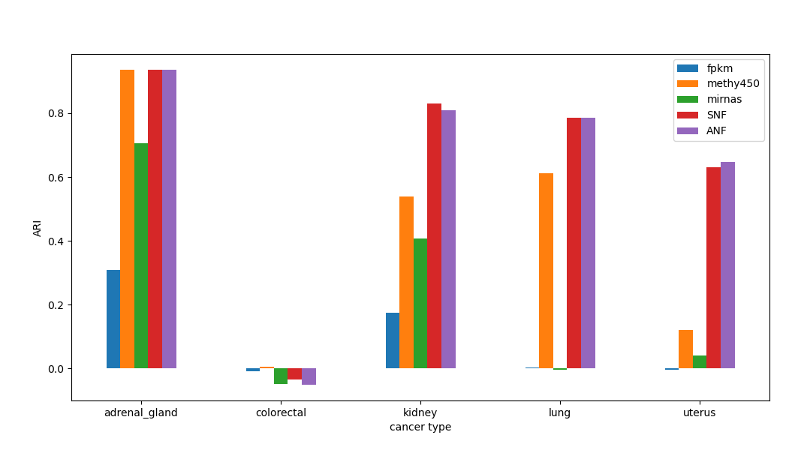
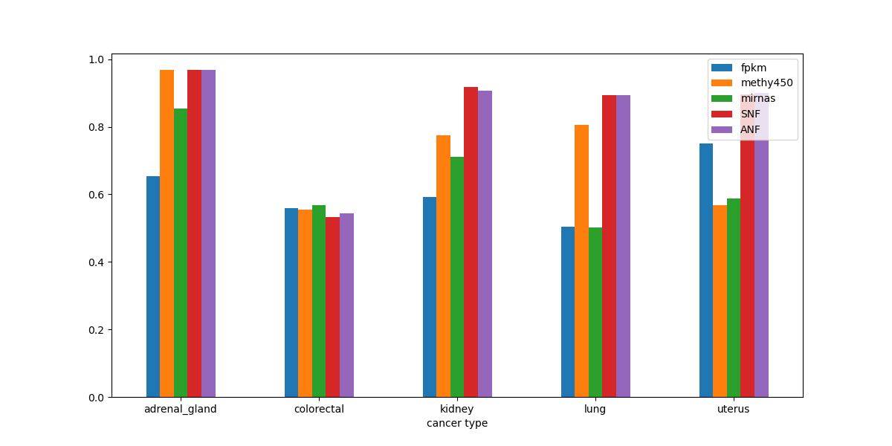
Evaluate with Labeled Data
NMI
ARI
RI

Slide 18
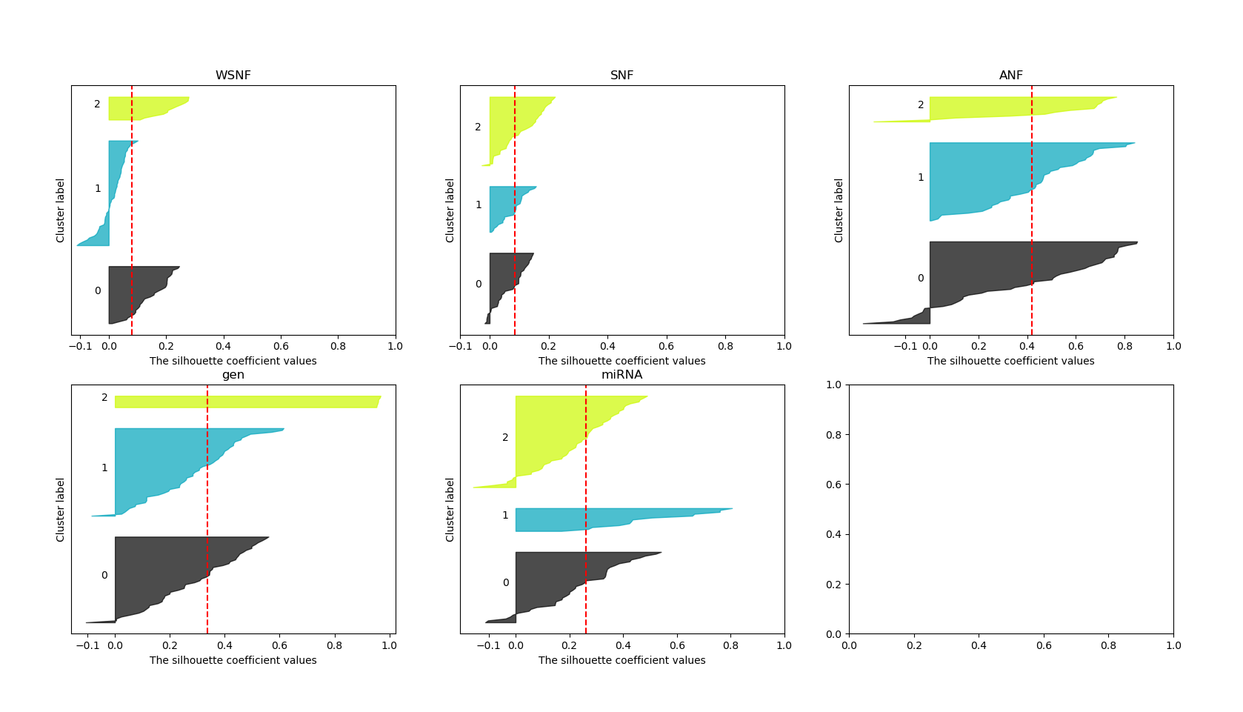
Silhouette score

Slide 19
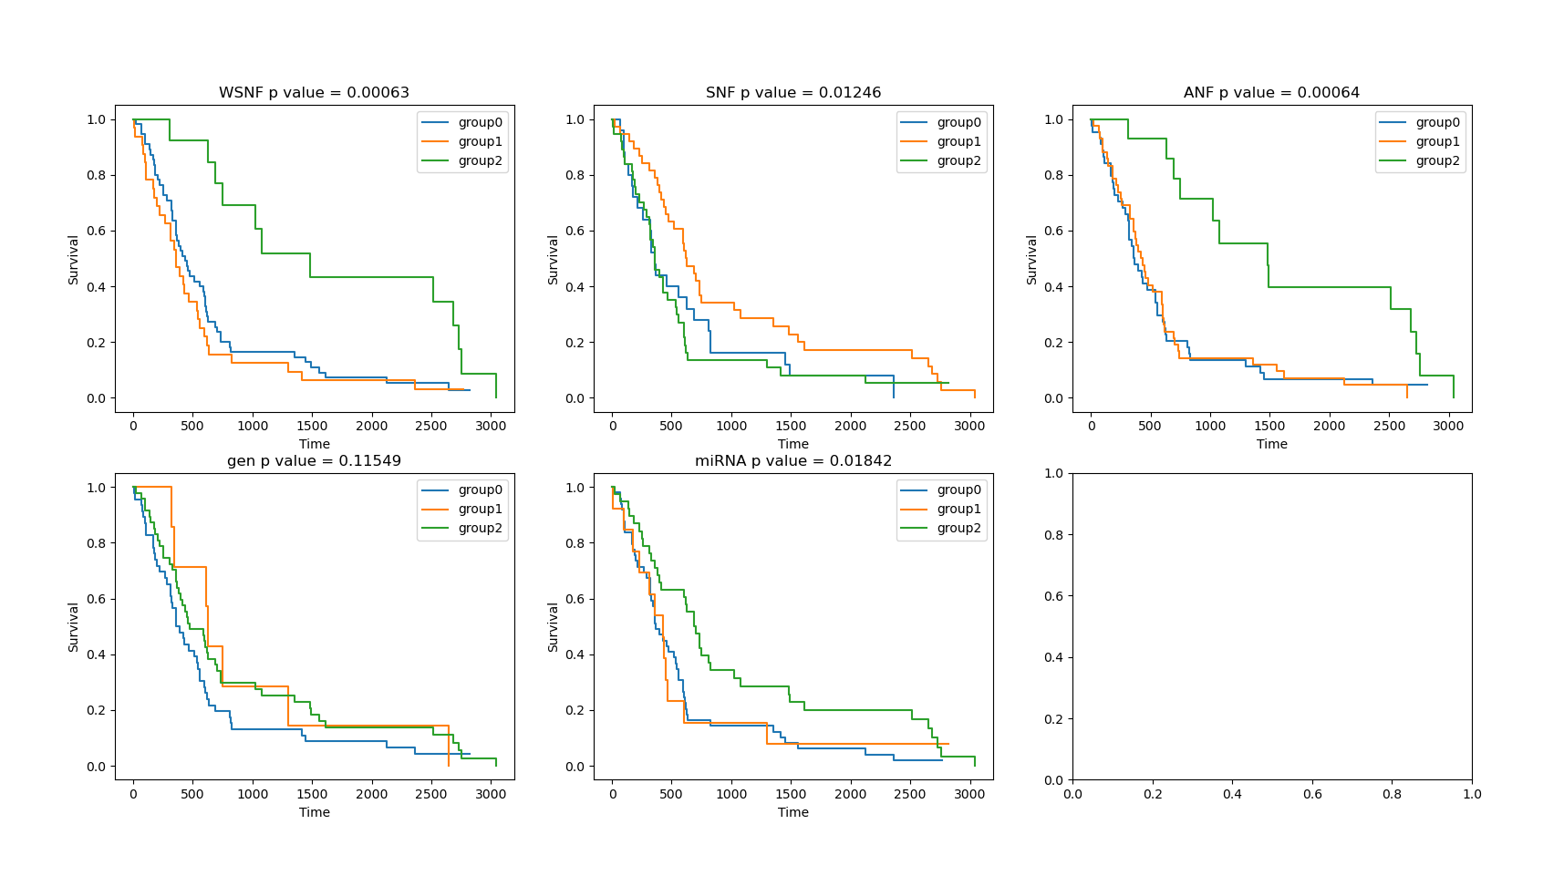
Logrank test

Slide 20
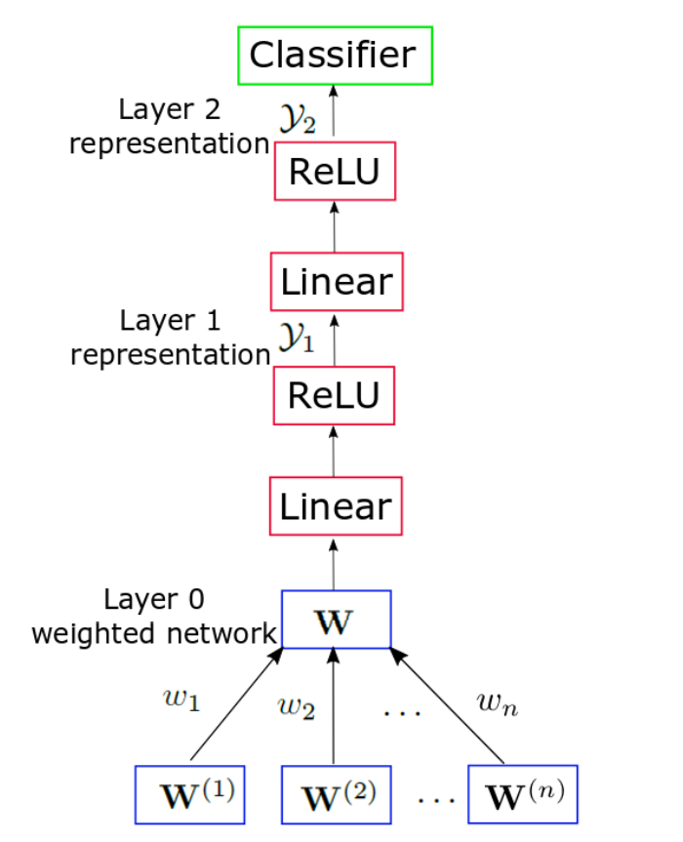
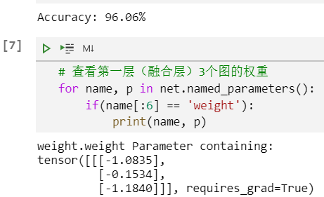
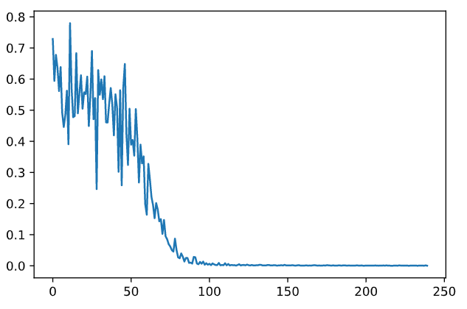
Machine Learning on Affinity Networks
Linear combination + 2 full-connected layers
Learn from true type information / ANF cluster results
few shot learning
result
train

Slide 21
References
Wang B, Mezlini A M, Demir F, et al. Similarity network fusion for aggregating data types on a genomic scale
Xu T, Le TD, Liu L, Wang R, Sun B, et al. (2016) Identifying Cancer Subtypes from miRNA-TF-mRNA Regulatory Networks and Expression Data.
Ma T, Zhang A. Affinity network fusion and semi-supervised learning for cancer patient clustering

